Slide 1
Digital Forensics Lecture-4
By- Dr.subhranil Das
Assistant Professor
School of computer Science

Slide 2

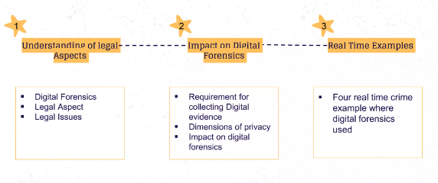
Contents

Slide 3
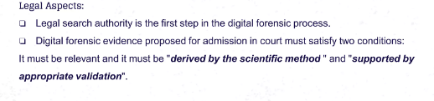
Legal Aspects

Slide 4
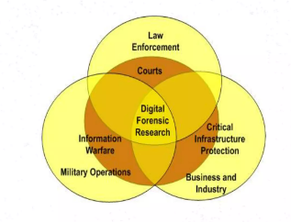
Overview

Slide 5
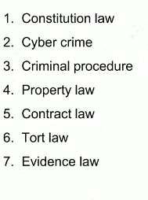
Legal Issues

Slide 6
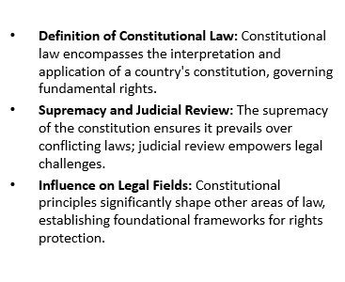
Constitutional Law

Slide 7
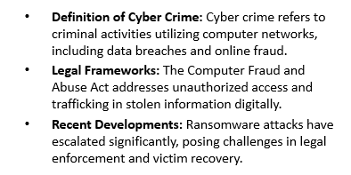
Cyber Crime

Slide 8
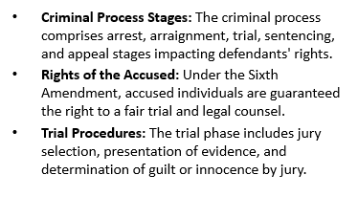
Criminal Procedure Stages

Slide 9
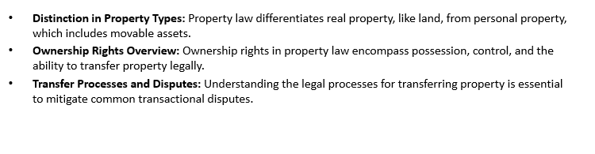
Property Law

Slide 10
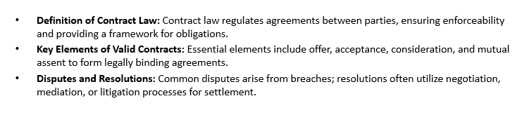
Contract Law

Slide 11
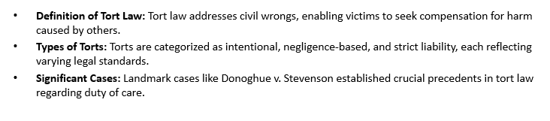
Tort Law

Slide 12
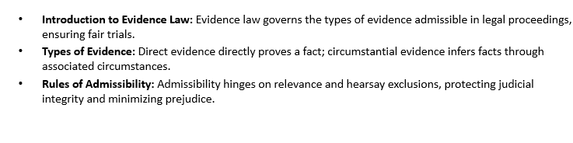
Evidence Law

Slide 13
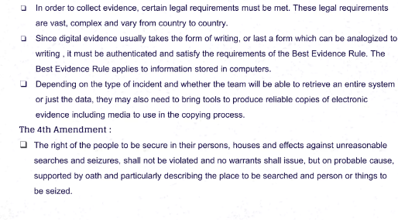
Legal Requirements for collecting Digital Evidence

Slide 14
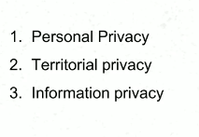
Dimensions of Privacy

Slide 15
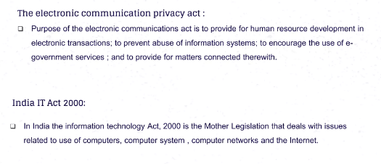
Indian Privacy Act

Slide 16
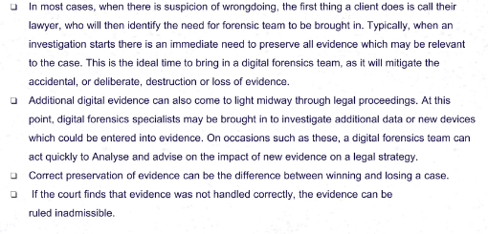
Impact of the legal aspects on Digital Forensics

Slide 17
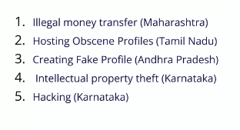
Real Time Digital Forensics Example

Slide 18
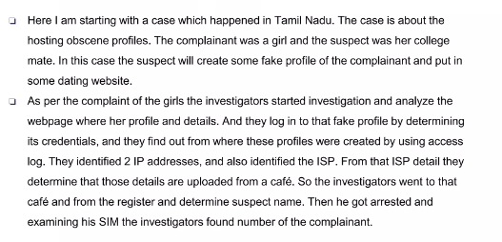
Example 1 (Hosting Obscene Profiles)

Slide 19
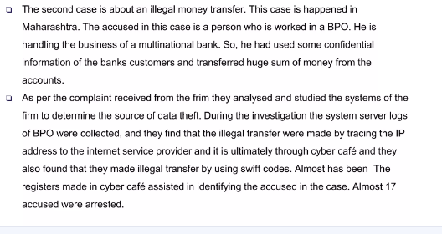
Example 2 (Illegal Money Transfer)

Slide 20
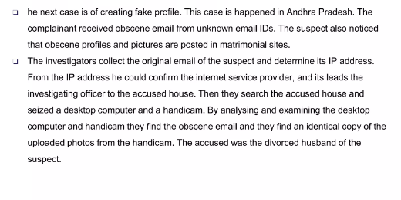
Example 3 (Create Fake Profile)

Slide 21
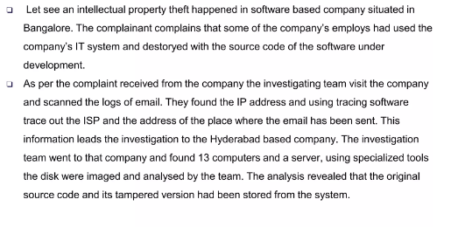
Example 4 (Intellectual Property Theft)

Slide 22
Next Lecture
Introduction to digital evidence acquisition

